Slide 1
To do web application Project
By Adigwe (Adi) Uraih

Slide 2
Introduction
Name: Adigwe Uraih
How I approached the specification:
Created my risk log, Jira board and ERD
Once I was able to start the code, I wrote down all the relevant tasks that I needed to do
Planned how and when I should I complete individual tasks, while leave time for contingencies just in case the project was delayed

Slide 3
SPRING PLAN
What needs to be included:
CRUD functionality- create, read, update and deleted
Working front end
All the must have and should have user stories
What I hoped to achieve:
Implementation of the could have user story
At least 80% test coverage

Slide 4
Consultant journey
Technologies learnt:
Spring
Javascript
HTML
CSS
Bootstrap
Postman
Sonarqube

Slide 5
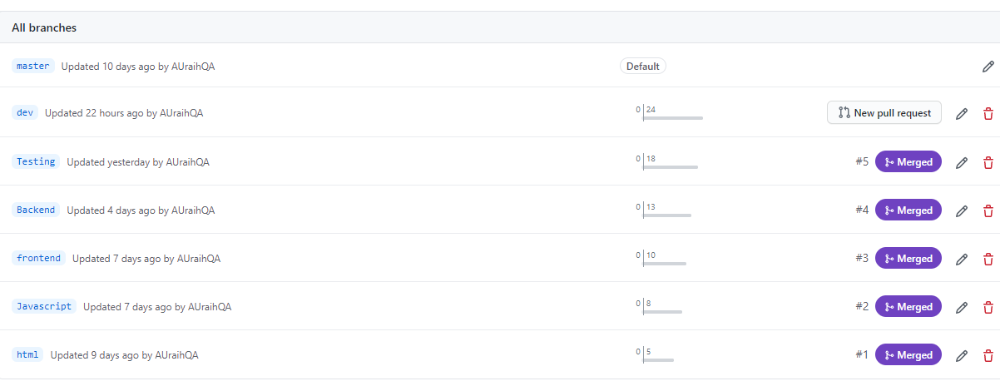
Version control
Branches:
Master
Dev
Javascript
HTML
Testing
Backend
Frontend
The branches where I worked on the features were Items, Orders and Testing.

Slide 6
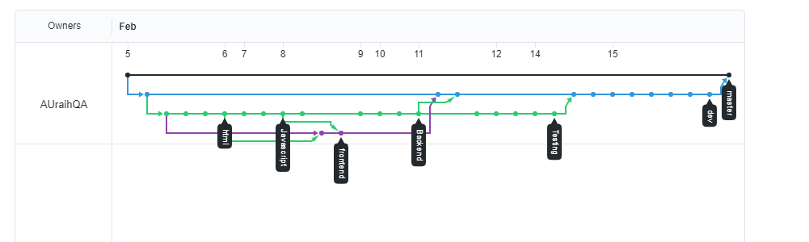
NETWORK

Slide 7
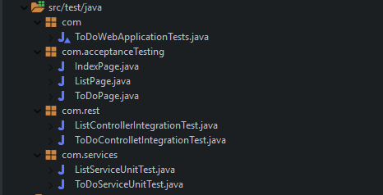
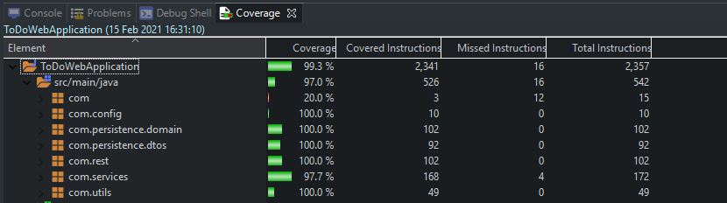
Testing

Slide 8
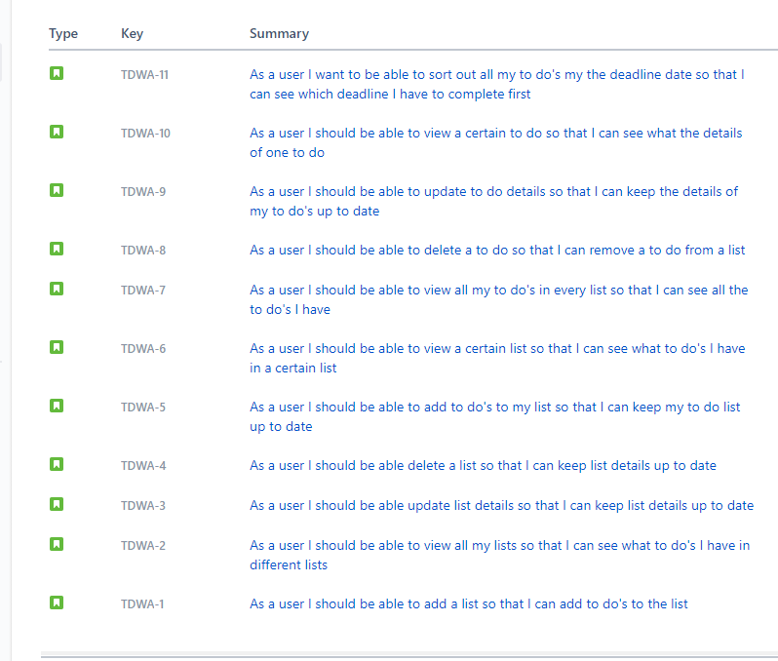
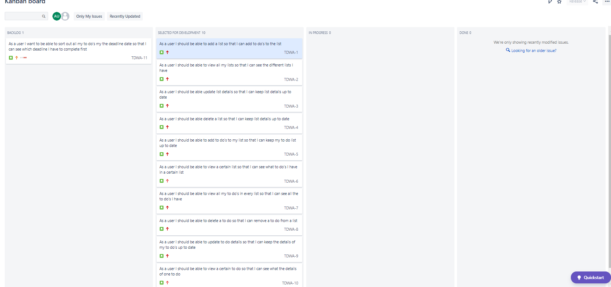
User stories

Slide 9
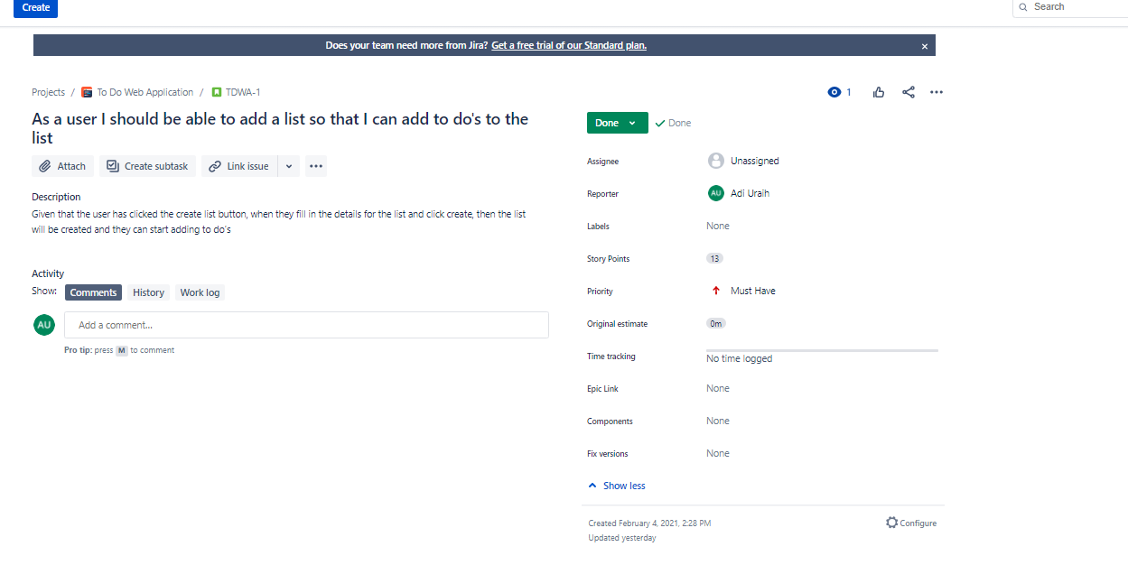
Example of acceptance criteria

Slide 10
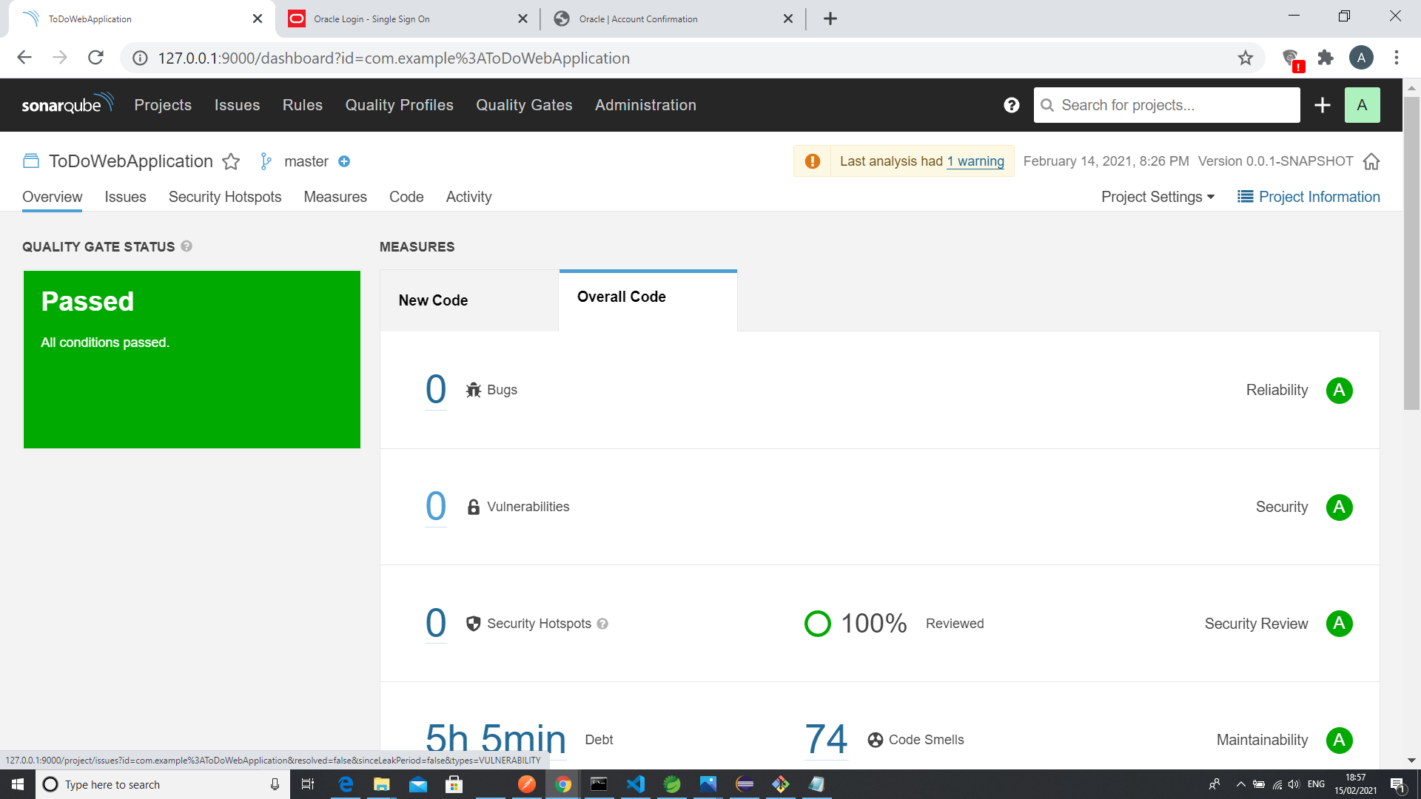
STATIC ANALYSIS

Slide 11
SPRINT REVIEW
I was able to complete all must have user stories
The user story to sort to dos by the deadline date was left out due to time constraints

Slide 12
SPRINT RETROSPECTIVE
What went well?
All must have user stories were completed
80% of code was covered
What could be improved?
Time left to include could have user stories
Generating extent reports for acceptance tests
Use of CSS to style web page
Use of the web page e.g., not having to click clear to get rid of generated items

Slide 13
Conclusion
Expanded my knowledge on a wide range of technologies
Was able to know where I am at regarding what has been taught
Adding more risks to risk log
Need to be able to generate extent reports

